Slide 1
Greedy Method
Unit - 2

Slide 2
Introduction
The greedy method suggests that one can device an algorithm that works in stages, considering one input at a time.
Most of the problems have n inputs and require us to obtain a subset that satisfies some constraints.
Any subset that satisfies these constraints is called a feasible solution.
We need to find a feasible solution that either maximizes or minimizes a given objective function.
  A feasible solution that does this job is called an optimal solution.
There may be many feasible solutions but all of them may not be optimal.

Slide 3
Introduction
The greedy method suggests that one can device an algorithm that works in stages, considering one input at a time.
At each stage, a decision is made regarding whether a particular input is in an optimal solution.
This is done by considering the inputs in an order determined by some selection procedure.

Slide 4
Subset Paradigm
If the inclusion of the next input into the partially constructed optimal solution will result in an infeasible solution, then this input is not added to partial solution. Otherwise, it is added.
The selection procedure itself is based on some optimization measure.
This measure can be the optimization function.
In fact, several different optimization measures may be plausible for a given procedure.
Most of these will result in algorithms that generate suboptimal solution.
This version of the greedy technique is called “subset paradigm”.
For example, “Knapsack Problem”, “Minimum Cost Spanning Trees”

Slide 5
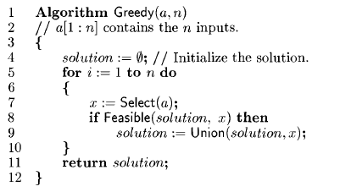
Greedy Method control abstraction for the Subset Paradigm
Select function is used to select an input from a[] and removes it.
  The selected value is assigned to x.
Feasible is a Boolean valued function that determines whether x can be included into the solution or not.
Union combines x with the solution and updates the objective function.

Slide 6
Ordering Paradigm
For problems that do not call for the selection of an optimal subset, in the greedy method, we make decisions by considering the input in some order.
Each decision is made using an optimization criterion that can be computed using decisions already made.
This version of greedy method is called “Ordering Paradigm”.
For example, “Optimal Storage on Tapes”

Slide 7
Knapsack Problem
We are given n objects and a knapsack or bag.
Object i has weight w_{i} and the knapsack has capacity m.
If a fraction x_{i} , 0 <= x_{i} <= 1 of object i is placed into the knapsack then a profit of p_{i}x_{i} is earned.
The objective is to obtain a filled knapsack that maximizes the profit.
Since the knapsack capacity is m, we require the total weight of all chosen objects to at most m.

Slide 8
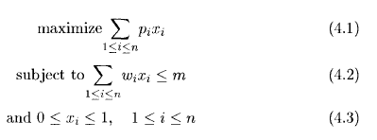
Knapsack Problem
Formally, the problem can be stated as:
The profit and weights are positive numbers.
The feasible solution is any set (x₁,…x_{n}) satisfying equation 4.2 & 4.3.
The optimal solution is a feasible solution for which eq. 4.1 is maximized.

Slide 9
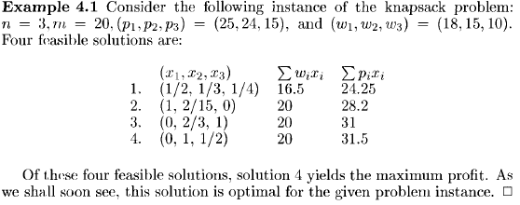
Example of KP

Slide 10
Knapsack Problem
Knapsack problem fits the subset paradigm because it calls for selecting the subset of the objects.
There are three measures which can be used to determine that which object to include next.
  Total Profit
  Capacity used
  Ratio of profit to weight

Slide 11
Approach – 1 Total Profit
First we can try to fill the knapsack by including next the object with largest profit.
If an object under consideration doesn’t fit, the a fraction of it is included to fill the knapsack.
Thus each time an object is included into the knapsack, we obtain the largest possible increase in profit value.
The difficulty with this approach is, if only a fraction of the last object is included, then it may be possible to get a bigger increase by using a different object.
E.g. if we have 2 units of space left and two objects (Pi=4,Wi=4) & (Pj=3,Wj=2) then using j is better than using half of i.
Suppose this selection strategy is applied on the following example.
n=3, m=20, (p₁,p₂,p₃)=(25,24,15), (w₁,w₂,w₃)=(18,15,10)

Slide 12
Approach – 1 Total Profit
Object one has the largest profit value P1=25. So, it is placed into the knapsack first.
Hence, x1=1 and profit of 25 is earned.
Only 2 units of knapsack capacity is left.
Object 2 has the next largest profit P2=24. but w2=15 and it doesn’t fit into the knapsack.
Using x2=2/15 fills the knapsack exactly earning the profit of 3.2.
So, the resulting solution is (x1,x2,x3)=(1, 2/15, 0), the weight accumulated is 20 and the earned profit is 28.2.
So, the solution is seen to be suboptimal.
The method is termed as greedy because at each step we chose to introduce that object which would increase the objective function value the most.
However, this greedy method did not yield an optimal solution.

Slide 13
Approach – 2 Capacity Used
In the previous approach it did not yield an optimal solution because even though the objective function value takes on the large increases at each step, the number of steps is few as the knapsack capacity is used at a rapid rate.
So, let us try to be greedy with capacity and use it up as slowly as possible.
This requires us to consider the objects in order of nondecreasing weights Wi.
Solution no. 3 is the result of this approach.
However, this too is suboptimal.
So, even though capacity is used slowly , profits aren’t coming in rapidly enough.

Slide 14
Approach – 3 Ratio of Profit to Weight
Let us balance between the rate at which the profit increases and the rate at which capacity is used.
At each step we include that object which has the maximum profit per unit of capacity used.
This means that objects are considered in order of the ratio of Pi/Wi.
Solution 4 of previous example is result of this approach.
E.g.
If the objects have already been sorted into nonincreasing order of Pi/Wi, then following function can be used to obtain solutions corresponding to this strategy.
 | 25/18 | 24/15 | 15/10
Profit/weight | 1.3 | 1.6 | 1.5
Priority | 3 | 1 | 2

Slide 15
Algorithm GreedyKnapsack(m,n)
    Algorithm GreedyKnapsack(m, n)
    //p[1:n] and w[1:n] contain the profits and weights respectively of the n objects ordered such that p[i]/w[i] ≥ p[i+1]/w[i+1]. m is knapsack size. x[1:n] is the solution vector.
    {
    for i:= 1 to n do x[i] = 0.0; // Initialize x.
    U := m; //unused capacity
    for i:= 1 to n do
    {
    if (w[i] > U) then break;
    x[i] = 1.0; U := U - w[i];
    }
    if (i ≤ n) then x[i] = U/w[i];
    }
    Disregarding the time to initially sort the objects, it requires only O(n) time.

Slide 16
Exercise
Trace the algo.
n=3, m=20, (p₁,p₂,p₃)=(25,24,15), (w₁,w₂,w₃)=(18,15,10)
Exercise # 11
n=7, m=15,
(P1,P2,…,P7)=(10,5,15,7,6,18,3)
(w1,w2,…,w7)=(2,3,5,7,1,4,1)

Slide 17
Optimal Storage on Tapes
There are n programs that are to be stored on a computer tape of length l.
Each program is of length l _{i ,} 1<=i<= n.
All the programs can be stored only if sum of all programs is <= l.
We will assume that whenever we want to retrieve a program, the tape is positioned at the front.
So, if programs are stored in the order I=i₁,i₂,…,i_{n} then the time required to retrieve i _{j} is t _{j} which is proportional to sum of length of programs preceding the i^{th} program ( ∑ l _{ik})
Mean Retrieval Time:
  If all programs are retrieved equally often then the expected or mean retrieval time
MRT = (1/n) ∑ t _{j} i.e. sum of all t _{j} / n.

Slide 18
Optimal Storage on Tapes
In the optimal storage on tape problem, we are required to find a permutation for the n prog.s so that when they are stored on tape in this order, the MRT is minimized.
This problem fits into ordering paradigm.
Minimizing the MRT is equivalent to minimizing
d(I) = ∑_{j}(∑_{k} l _{ik}), 1 ≤ j ≤ n, 1 ≤ k ≤ j
E.g. N=3, (l 1,l 2,l 3) = (5,10,3)
There are n! = 6 possible orderings.
So the optimal ordering is 3, 1, 2.
Ordering I | D(I) | Total
1,2,3 | 5+5+10+5+10+3 | 38
1,3,2 | 5+5+3+5+3+10 | 31
2,1,3 | 10+10+5+10+5+3 | 43
2,3,1 | 10+10+3+10+3+5 | 41
3,1,2 | 3+3+5+3+5+10 | 29
3,2,1 | 3+3+10+3+10+5 | 34

Slide 19
Minimum Cost Spanning Tree
Let G=(V, E) be an undirected connected graph.
A subgraph t=(V, E’) of G is a spanning tree of G iff t is a tree.
E.g. This figure shows a complete graph G of 4 nodes with 3 of its spanning trees.
(G) (t1) (t2) (t3)

Slide 20
Minimum Cost Spanning Tree
The inputs for this problem is an undirected graph, G=(V, E) in which each edge, e in E, has an associated positive edge length, denoted as Length( e ).
The output is a spanning tree of G(V, E) such that the total edge length, is minimal amongst all the possible spanning trees of G( V, E).
In a weighted graph each edge has weight assigned to it.
The weight may represent the cost of construction, the length of the link and so on.
The links selected for the spanning tree have to form a tree.

Slide 21
Minimum Cost Spanning Tree
We have to select edges to have minimum total cost. (Cost of the spanning tree is the sum of the costs of the edges in that tree)
Since selection of minimum cost spanning tree involves selection of subset of edges, this problem fits the subset paradigm.
  A spanning tree of G with minimum cost.
1
1
28
10
2
10
2
14
16
14
16
6
7
3
6
7
3
24
25
18
12
25
12
5
5
22
4
22
4
(G)
(t1)

Slide 22
Prim’s Algorithm
A greedy method to obtain a minimum cost spanning tree builds this tree edge by edge.
The algorithm will start with a tree that includes only a minimum-cost edge of G.
The next edge to be included should be such that results in minimum increase in the sum of the costs of the edges so far included.
The next edge (i, j) to be added is such that:
  i is a vertex already included in the tree
  j is a vertex not yet included
  cost[i, j] is minimum among all edges (k, l) such that k is in the tree and l is not in the tree.

Slide 23
Prim’s Algorithm
To determine the edge (i,j) efficiently, we associate with each vertex j not yet included in the tree a value near[j].
near[j]: a vertex in the tree such that cost[j,near[j]] is minimum among all choices for near[j].
near[j]=0 for all vertices j that are already in the tree.
The next edge to include is defined by the vertex j such that near[j] ≠ 0 (j not already in the tree) and cost[j,near[j]] is minimum.

Slide 24
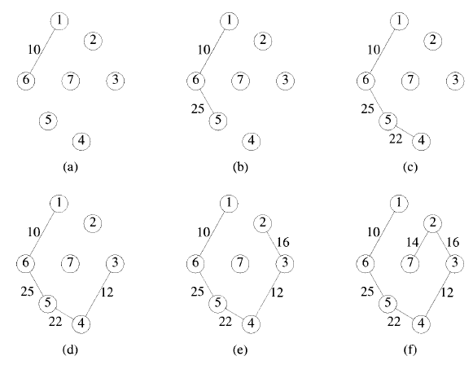
Stages of Prim’s Algorithm

Slide 25
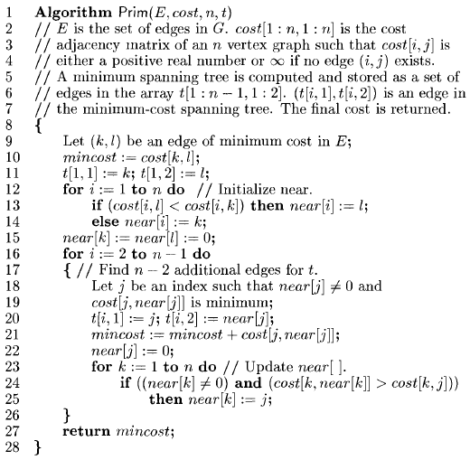
Prim’s Algorithm

Slide 26
Prim’s Algorithm
Line 9 selects a minimum-cost edge.
Lines 10 to 15 initialize the variables so as to represent a tree comprising only the edge (k,l).
In the for loop of line 16 the remainder of the spanning tree is built up edge by edge.
Lines 18 and 19 select (j, near[j]) as the next edge to include.
Lines 23 to 25 update near[].
Time complexity of the Prim’s algorithm is O(n²).

Slide 27
Kruskal’s Algorithm
In this method, the edges of the graph are considered in nondecreasing order of cost.
The set t of edges so far selected for the spanning tree be such that it is possible to complete t into a tree.
Thus, t may not be a tree at all stages in the algo.
In fact, it will generally only be a forest since the set of edges t can be completed into a tree iff there are no cycles in t.
Algorithm will start with a tree that includes all the n vertices of G and no edge is included.
The next edge (i, j) to be added is such that:
  Cost (i, j) is minimum among all the edges still not included
  Including (i, j) does not create a cycle.
  Continue selecting edges till n-1 edges have been selected.

Slide 28
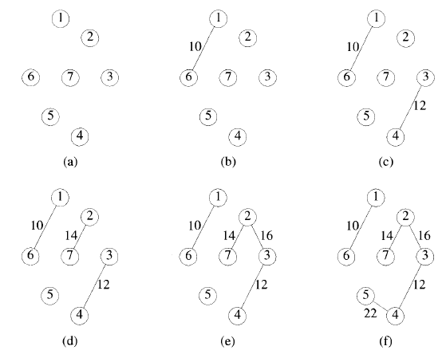
Stages of Kruskal’s Algorithm

Slide 29
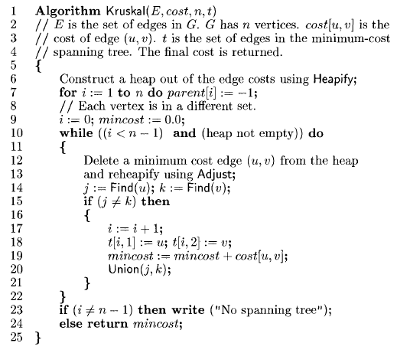
Kruskal’s Algorithm

Slide 30
Kruskal’s Algorithm
In line 6 an initial heap of edges is constructed.
In line 7 each vertex is assigned to a distinct set.
  The set t is the set of edges to be included in the minimum-cost spanning tree and i is the number of edges in t.
  The set t can be represented as a sequential list using a two-dimensional array t[1:n-1 , 1:2]
  Edge (u,v) can be added to t by the assignments t
    [i,1] := u
    [i,2] := v
In while loop of line 10, edges are removed from the heap one by one in non-decreasing order of cost.
Line 14 determines the sets containing u and v. (u and v should be in different sets)
The sets containing u and v are combined in line 20.
Line 23 determines whether a spanning tree was found.
Time complexity of Kruskal’s algorithm is O(|E| log |E|) , where E is the edge set of G.

Slide 31
Single-Source Shortest Paths
Graphs can represent the highway structure of a state or country.
In such graphs, Vertices represent cities & edges represent sections of highways.
Weights are associated with edges which represents distance between cities or time to travel that section of highway.
The problem is to determine the shortest path from any vertex V₀ to all other vertices in graph G(V, E).
The shortest path between Vo and other node is an ordering among a subset of the edges.
Hence, this problem fits into the ordering paradigm.

Slide 32
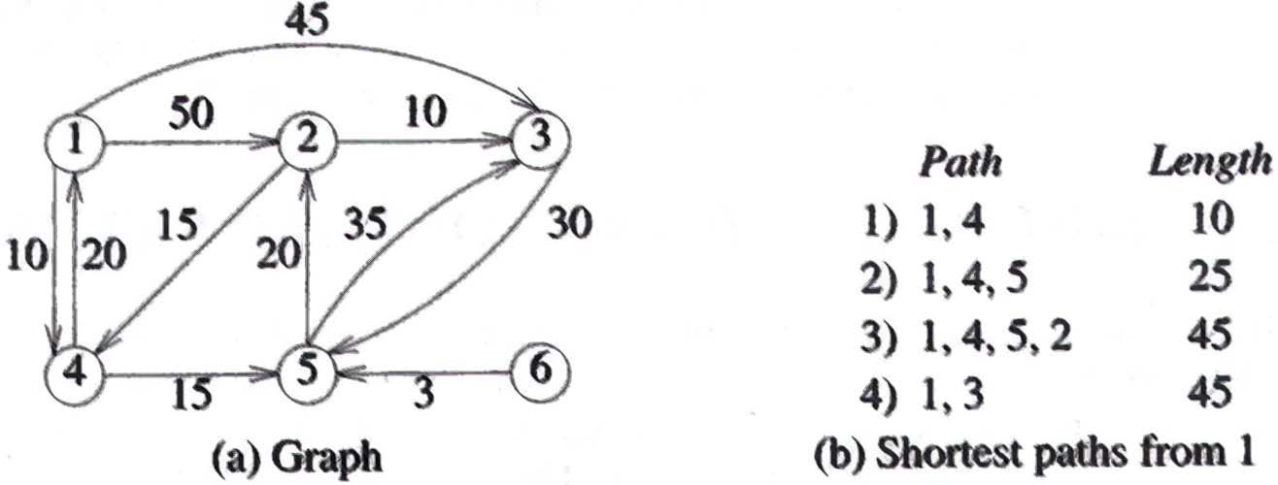
Single-Source Shortest Paths
The greedy way to generate the shortest paths from Vo to the remaining vertices is to generate these paths in nondecreasing order of path lengths.
First, a shortest path to the nearest vertex is generated.
Then a shortest path to the second nearest vertex is generated & so on.
E.g.

Slide 33
Single-Source Shortest Paths
Let S denote set of vertices(including V₀) to which shortest paths have already been generated.
For w S, dist [w] is the length of the shortest path starting from V_{o} passing through only those vertices which are in S and ending at w.
The observation:
  If next shortest path is to vertex u then it begins at V_{0,} goes through only those vertices which are in S and ends at u.
    There can be no intermediate vertex that is not in S.

Slide 34
Single-Source Shortest Paths
  The destination of the next path generated must be vertex u which has minimum distance dist[u] among all vertices not in S.
  If there are several vertices not in S with the same dist, then any of these may be selected.
  Having generated the shortest V₀ to u path, vertex u becomes a member of S. i.e. u ϵ S.
  At this point, the length of the shortest paths starting at V₀, going through vertices only in S, and ending at a vertex w not in S, dist[w] may change (i.e. decrease).
  Because of a path from V₀ to u to w, where the path from V₀ to u is the shortest such path and the path from u to w is an edge <u, w>.
  The length of this path is dist[u]+cost[u,w].

Slide 35
Dijkstra’s Algorithm
In the algorithm it is assumed that the n vertices of G are numbered 1 through n.
S[i]=0 if vertex i is not in S and S[i]=1 if it is.
Graph is represented by cost adjacency matrix cost[i, j] being the weight of the edge<i, j> and ∞ in case there is no edge <i, j>.
dist[j], 1 ≤ j ≤ n, is set of the length of the shortest path from vertex v to vertex j in a digraph G.
dist[v] is set to zero.

Slide 36
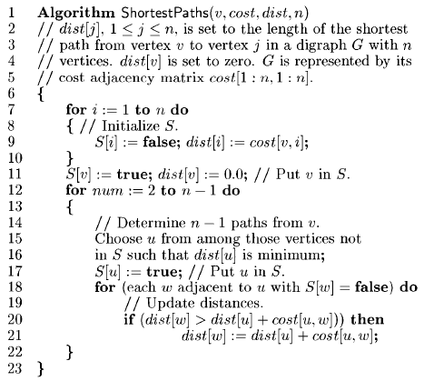
Dijkstra’s Algorithm

Slide 37
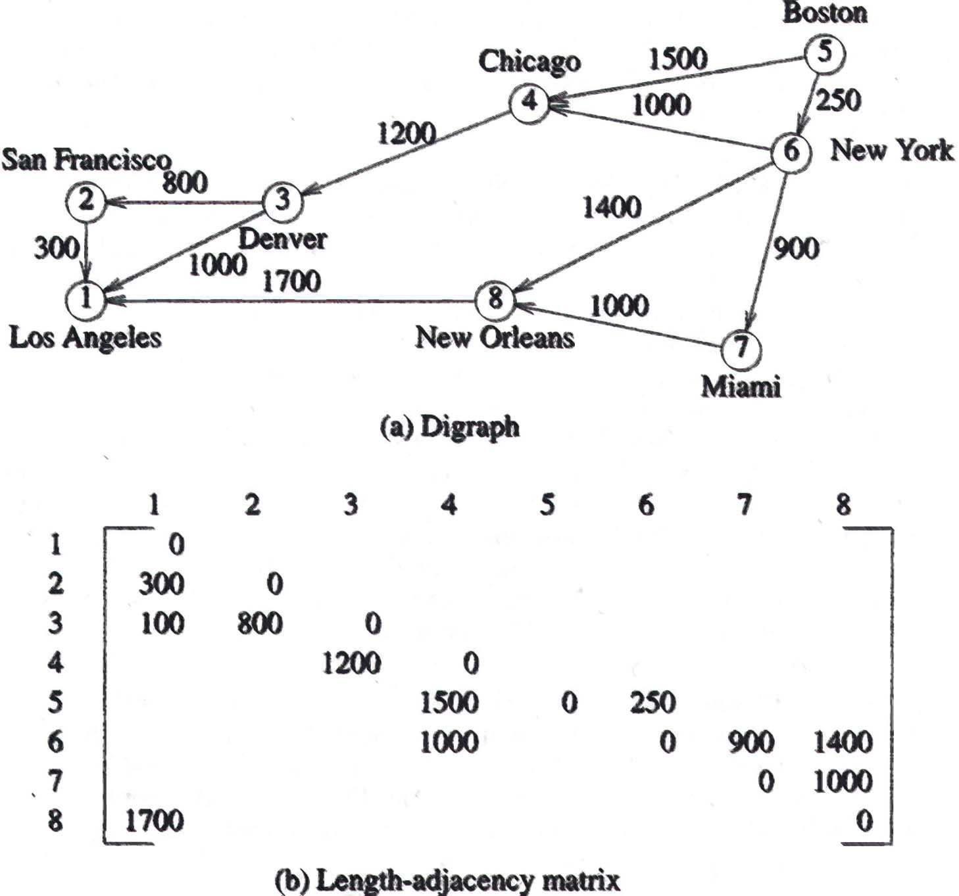
Example of Dijkstra’s Algorithm

Slide 38
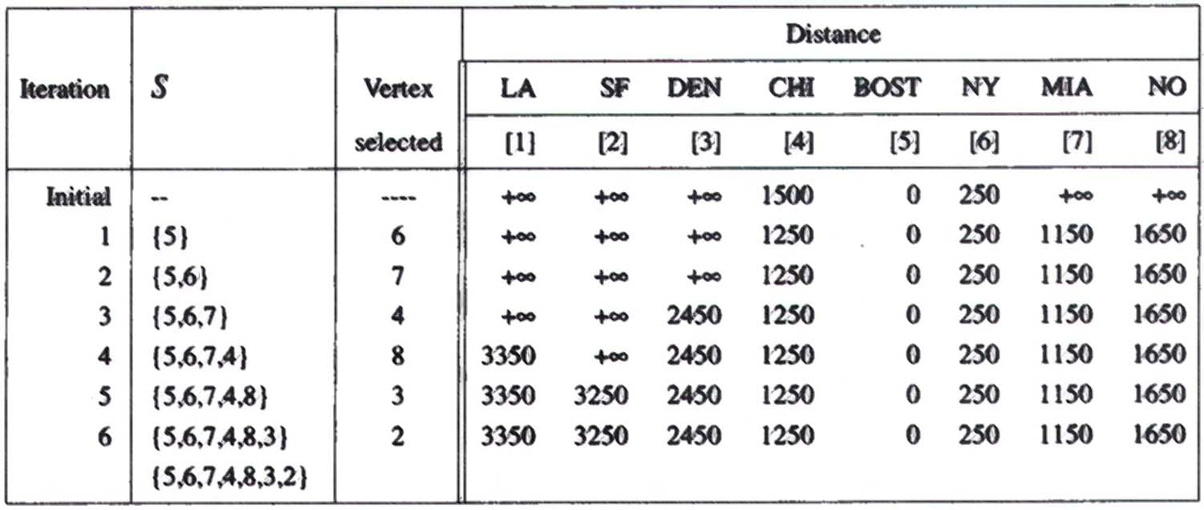
Action of Shortest Paths

